Slide 1




NEXT GEN EMPLOYABILITY PROGRAM
Creating a future-ready workforce
Team Members
College Name
Student Name : Adriel Joshua J
Student ID : au311121104002
Loyola ICAM College of Engineering and Technology

Slide 2

CAPSTONE PROJECT SHOWCASE
Project Title
MUSIC WEB APPLICATION USING DJANGO FRAMEWORK
Abstract | Problem Statement | Project Overview | Proposed Solution | Technology Used | Modelling & Results | Conclusion

Slide 3
Abstract
MusicBox is a personalized music player that suggests new tracks based on your preferences and trending genres. It seamlessly combines trend analysis with curated recommendations, enhancing your music discovery experience. With MusicBox, you can effortlessly explore and enjoy a variety of music that resonates with your unique style.
It personalizes your music discovery journey by learning your preferences over time and tailoring recommendations to your unique listening habits. With its seamless integration, MusicBox provides a convenient music player interface, allowing you to explore new discoveries directly within the app.
Source :

Slide 4
Problem Statement
Music listeners often struggle to discover new music that aligns with their evolving preferences and broader cultural shifts within the music industry. Music streaming services primarily focus on personalized recommendations based on past listening history potentially leading to stagnation in musical exploration.
MusicBox aims to address these challenges by creating a music player app that:
Analyzes music trends: Captures the dynamic nature of popular music by analyzing data and user behavior to identify emerging genres, artists, and styles.
Offers personalized recommendations: Leverages trend analysis to suggest music that aligns with both a user's individual taste and the current cultural zeitgeist.
Provides a seamless listening experience: Integrates music discovery with a user-friendly music player interface, allowing users to explore new music directly within the app.
By solving these problems, MusicBox can become a valuable tool for music listeners, fostering a sense of discovery and keeping them engaged with the ever-evolving landscape of music.
Source :

Slide 5
Project Overview
MusicBox is more than just a music player; it's your personalized music discovery companion. By analyzing trends, MusicBox offers tailored music recommendations that match your current taste while also introducing you to new and exciting sounds, making every listening session a journey of discovery.
With MusicBox, seamless integration is key. You can explore and play fresh music directly within the app's built-in music player, eliminating the need to switch between different platforms and enhancing your overall listening experience.
Who's it for? MusicBox is designed for music enthusiasts who crave new experiences. Whether you're looking to discover hidden gems or stay ahead of emerging trends and artists, MusicBox empowers you to break free from routine playlists and explore the vibrant world of music.
Source :

Slide 6
Proposed Solution
.
Here's an expanded explanation of the proposed solution for MusicBox, diving deeper into each component:
1. Personalized Search Engine:
The search functionality in MusicBox allows users to find songs, artists, or albums by entering keywords into a search bar. When a search query is submitted, the system retrieves relevant matches from the database based on the entered keywords. It then presents the results to the user, typically in a list format, displaying matching songs, artists, or albums that match the search criteria. Users can then select from the search results to access the desired content and continue exploring or playing music within the platform.
User Experience Impact: Efficient search functionality significantly enhances the user experience by allowing quick access to desired content, leading to higher satisfaction levels and increased engagement. This seamless experience encourages users to explore more, create playlists, and interact with social features, contributing to improved retention rates.
Technical Robustness and Scalability: A well-performing search system reflects the platform's technical strength and scalability. It demonstrates the ability to handle large data volumes and complex queries without sacrificing speed or accuracy. This reliability is crucial for maintaining platform performance as the user base and content library grow.
Source :

Slide 7
Competitive Advantage and Personalization: Platforms with efficient search capabilities gain a competitive edge by offering a smooth user experience and personalized content recommendations. Leveraging user behavior data, the search function can deliver relevant results and suggestions, further enhancing user satisfaction and loyalty while standing out in a competitive market.
2. Personalized Recommendation System:
User Interaction Integration:
Feedback Mechanism: Allow users to like/dislike recommendations, providing valuable data for the recommendation engine to improve its accuracy.
Playlists and Saved Songs: Analyzing user-created playlists and saved songs can reveal specific tastes and genres they enjoy.
Explorative Listening: Track user behavior when exploring new recommendations to understand their openness to different styles.
Source :

Slide 8
Recommendation Delivery and Refinement:
Personalized Playlists: Generate playlists curated with suggested songs, considering user preferences and trends.
New Release Recommendations: Highlight trending new releases from artists or genres the user might enjoy.
"Discover Weekly" Style Recommendations: Regularly generate personalized recommendations based on the user's evolving listening habits and current music trends.
A/B Testing: Continuously test different recommendation strategies to optimize their effectiveness in engaging users.
Additional Considerations:
Privacy: User privacy is paramount. MusicBox would need to ensure anonymized data collection and transparent user consent for data usage.
Scalability: The system needs to handle a potentially large user base and ever-growing data volumes.
Real-Time Updates: MusicBox should strive to deliver real-time or near real-time recommendations to keep users informed about the latest trends.
User Interface: Design a user-friendly interface for exploring recommendations, managing playlists, and providing feedback.
Source :

Slide 9


Technology Used
Front-end
Back-end
Source :

Slide 10
Modelling & Results
Since MusicBox is still in the proposal stage, we can't showcase real-world results. However, here's a breakdown of potential modeling techniques and expected outcomes:
1. Search Functionality:
The search functionality in MusicBox allows users to find songs, artists, or albums by entering keywords into a search bar. When a search query is submitted, the system retrieves relevant matches from the database based on the entered keywords. It then presents the results to the user, typically in a list format, displaying matching songs, artists, or albums that match the search criteria. Users can then select from the search results to access the desired content and continue exploring or playing music within the platform.
2. Personalized Recommendation Modeling:
Evaluation Metrics:
For Trend Analysis: Precision (accuracy of identifying rising trends), Recall (capturing significant portion of emerging trends).
For Recommendation System: Click-through rate (user engagement with recommendations), Normalized Discounted Cumulative Gain (NDCG) (ranking quality of recommendations).
Source :

Slide 11
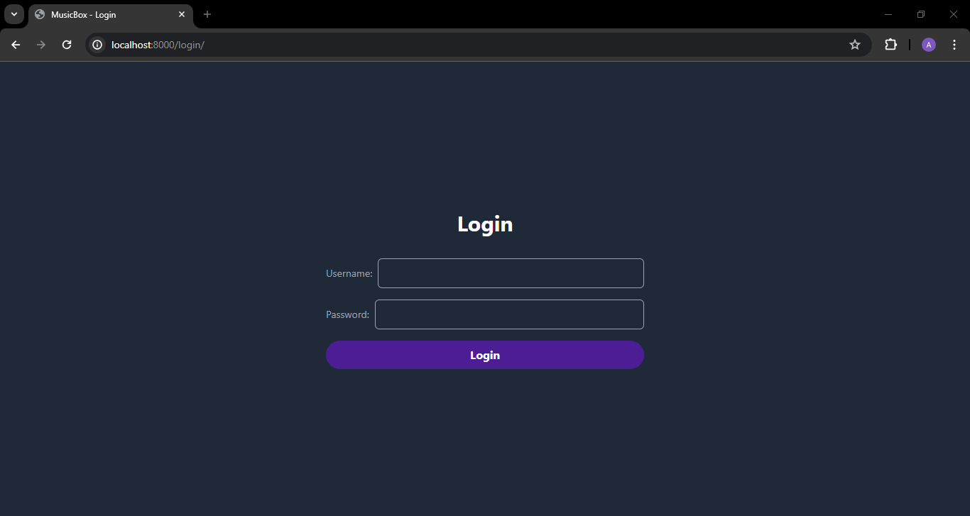
Login-Page

Slide 12
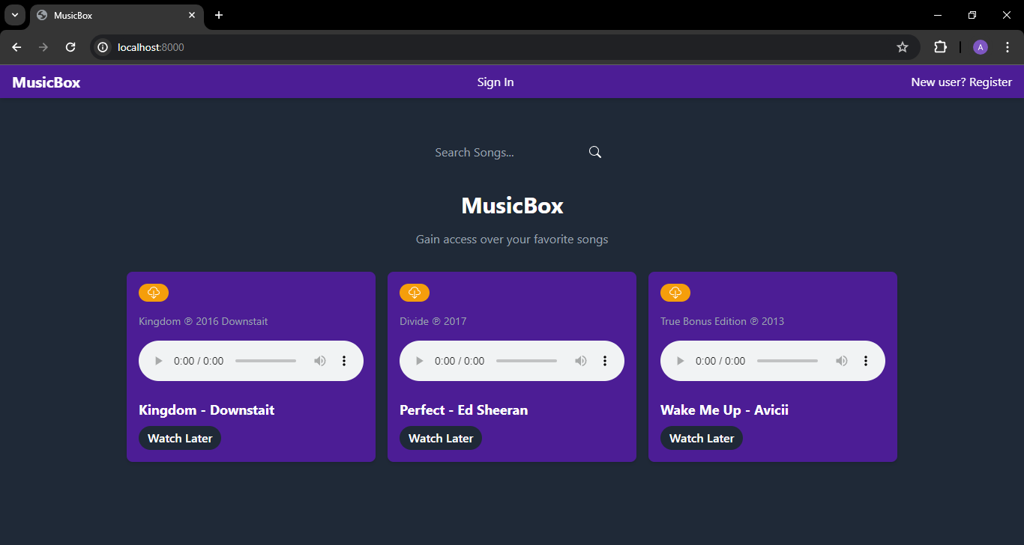
Home-Page

Slide 13
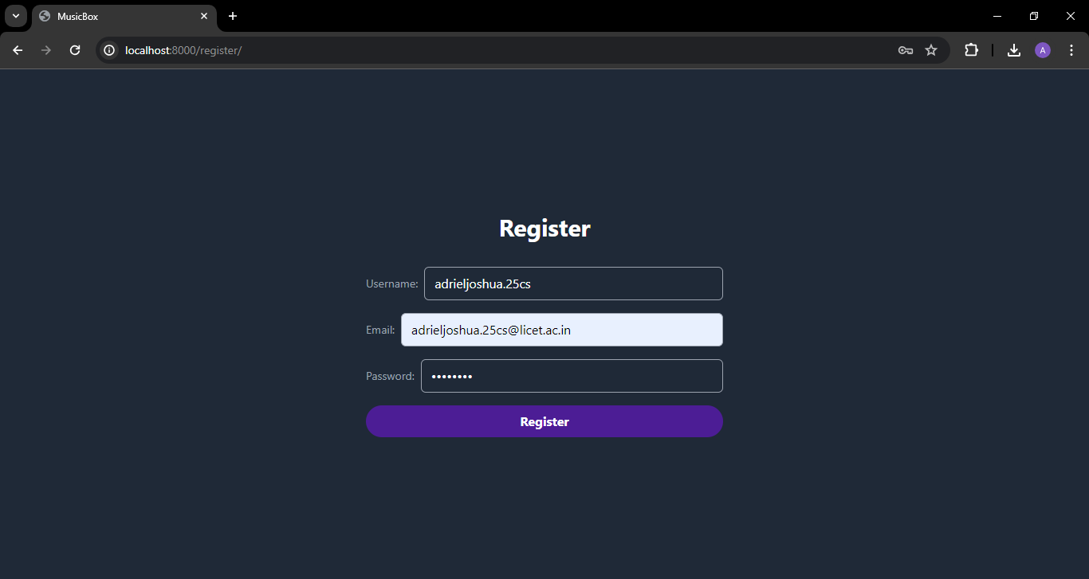
Register New User-Page

Slide 14
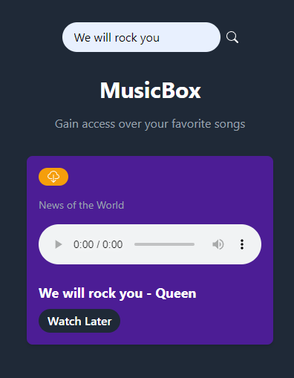
Search Functionality

Slide 15
Future Enhancements:
Advanced Playback Features:
Implement features like volume control, queue management, and seeking within the audio player for a seamless listening experience.
Mobile App Development:
Create a mobile application for MusicBox to enable users to access their music library on the go, requiring expertise in mobile development frameworks like React Native or Flutter.
Social Features:
Integrate social functionalities such as allowing users to follow each other, share playlists, and view their friends' listening activities for a more interactive music community.
Genre and Mood Classification:
Incorporate music genre and mood classification to categorize songs, enabling users to explore and discover music based on their preferred genres or moods.
Song Uploads:
Enable authenticated users to upload their own songs to MusicBox, taking into account storage limitations to manage user-generated content effectively.
Lyrics Integration:
Display song lyrics alongside the audio player, allowing users to sing along and enhance their music experience with synchronized lyrics.

Slide 16
Conclusion
MusicBox is a Django-based music streaming platform offering essential features like song playback, downloads, and a watch later list. This project showcases a robust Django backend for an audio streaming application. Future plans include user authentication, playlist creation, search functionalities, and potentially user-generated content (subject to storage and copyright constraints). MusicBox aims to grow into a feature-rich and personalized music streaming service.
Beyond its core functionalities, MusicBox aims to address diverse user preferences and foster community engagement. The roadmap includes integrating social features for playlist sharing, friend following, and collaborative music discovery. Advanced music analysis for genre and mood classification will allow users to curate their listening experience based on specific styles or atmospheres. Ultimately, MusicBox envisions becoming a comprehensive music platform that seamlessly combines individual enjoyment with the excitement of shared musical exploration.
Source :

Slide 17
Thank You!
Notes:
Thank You !!

